Slide 1
My Idol Researcher

Slide 2
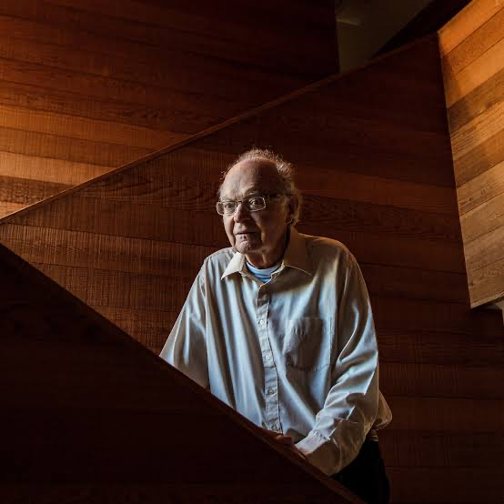
Donald E. Knuth
Author : The Art of Computer Programming
Recipient : Turing Award, Algorithm Analysis
Recipient : National Medal of Science
Recipient : John von neumann medal
Recipient : Kyoto prize

Slide 3
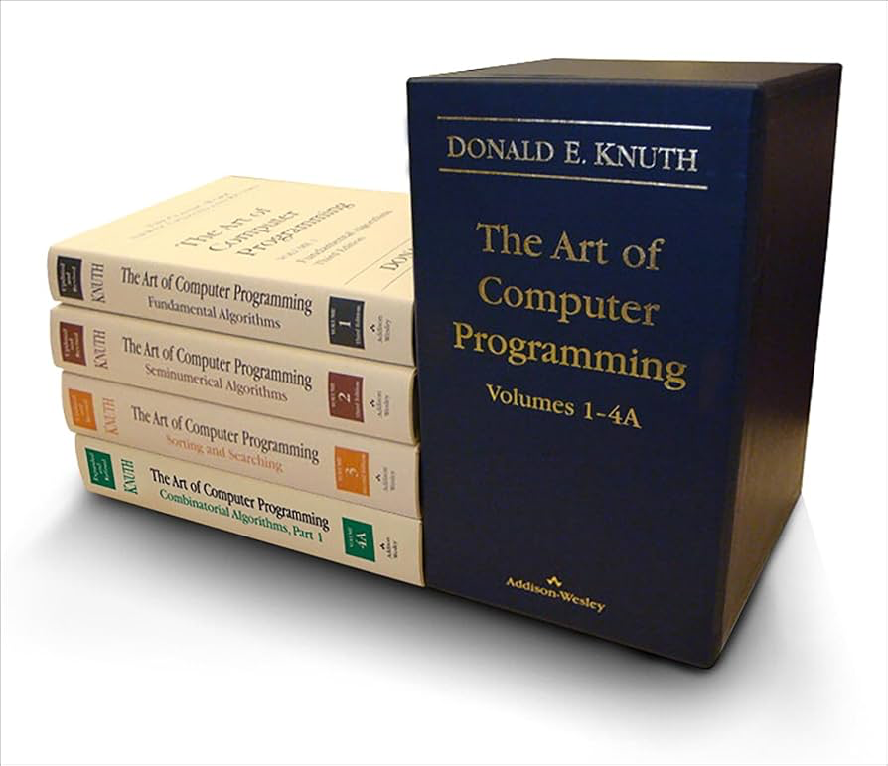
The Art of Computer Programming
Core algorithms and data structures; deep analysis that uncovers the elegant foundations of programming

Slide 4
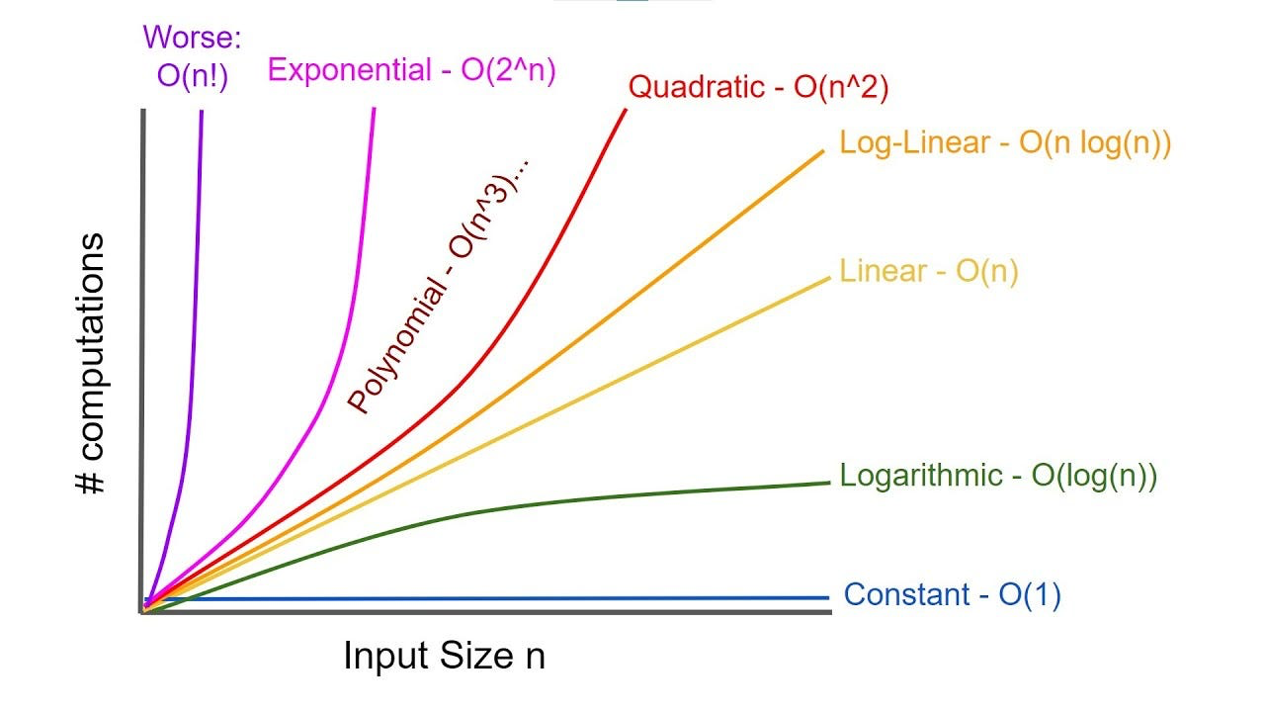
Analysis of Algorithm

Slide 5
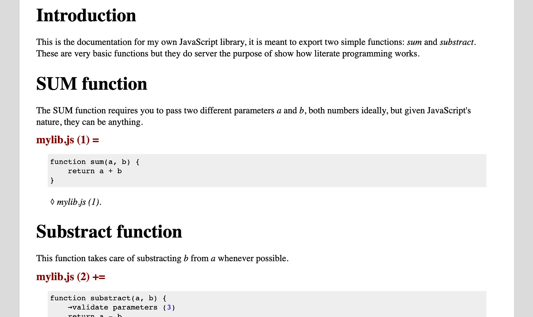

Literate Programming : Methodology that combine Code with Documentation

Slide 6
What is Research?

Slide 7
What is Research?
Research is a systematic process used to deeply explore a specific topic or area. The goal is to either question existing ideas or discover something new that might be useful in the future.

Slide 8
Types of research
Fundamental : aims to expand general knowledge and understanding without focusing on practical applications.
Applied : focuses on solving specific, practical problems using scientific methods.
Quantitative : research involves the collection and analysis of numerical data to identify patterns, relationships, or trends.
Qualitative : explores non-numerical data to understand experiences, behaviors, and social phenomena in depth.

Slide 9
Examples from theses @ Chula Computer Engineering
A design of FPGA framework for quantum computing simulation : Fundamental
A scalable shapelet discovery for time series classification : Fundamental
Fully automatic 3D facial cosmetic surgery simulation : Applied
Object detection in intelligent billing system for conveyor belt sushi restaurant : Applied

Slide 10
References :
A design of FPGA framework for quantum computing simulation : Fundamental
http://cuir.car.chula.ac.th/handle/123456789/80133?src=%2Fbrowse%3Ftype%3Ddiscipline%26sort_by%3D2%26order%3DDESC%26rpp%3D20%26etal%3D-1%26value%3DComputer%2BScience%26offset%3D20%26brw_total%3D51%26brw_pos%3D23
A scalable shapelet discovery for time series classification : Fundamental
http://cuir.car.chula.ac.th/handle/123456789/63652?src=%2Fbrowse%3Ftype%3Ddiscipline%26sort_by%3D2%26order%3DDESC%26rpp%3D20%26etal%3D-1%26value%3DComputer%2BScience%26offset%3D20%26brw_total%3D51%26brw_pos%3D36
Fully automatic 3D facial cosmetic surgery simulation : Applied
http://cuir.car.chula.ac.th/handle/123456789/80130?src=%2Fbrowse%3Ftype%3Ddiscipline%26sort_by%3D2%26order%3DDESC%26rpp%3D20%26etal%3D-1%26value%3DComputer%2BScience%26offset%3D20%26brw_total%3D51%26brw_pos%3D38
Object detection in intelligent billing system for conveyor belt sushi restaurant : Applied
http://cuir.car.chula.ac.th/handle/123456789/80146?src=%2Fbrowse%3Ftype%3Ddiscipline%26sort_by%3D2%26order%3DDESC%26rpp%3D20%26etal%3D-1%26value%3DComputer%2BScience%26offset%3D20%26brw_total%3D51%26brw_pos%3D21

Slide 11
What I have learned from the speaker

Slide 12
What I have learned from the speaker
ความรู้ในสายคอมพิวเตอร์ จำเป็นต้องเรียนรู้สิ่งใหม่ ๆ อยู่เสมอ เนื่องจากมีเทคโนโลยีใหม่ ๆ เกิดขึ้นทุกวัน
เราไม่ควรเลือกหัวข้อวิจัยถ้าเราไม่มีความรู้และความสนใจในด้านนั้น

